Slide 1



Mydoh Assignment
Usman Naveed

Slide 2
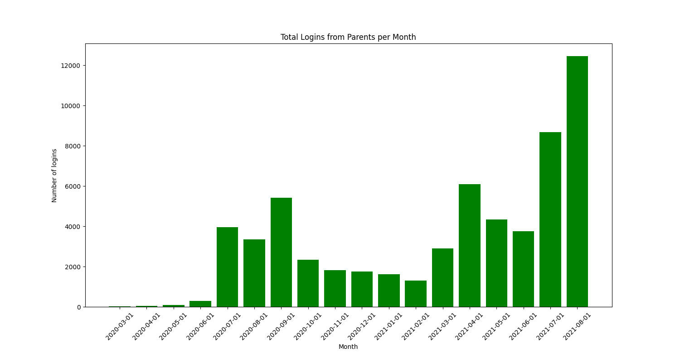
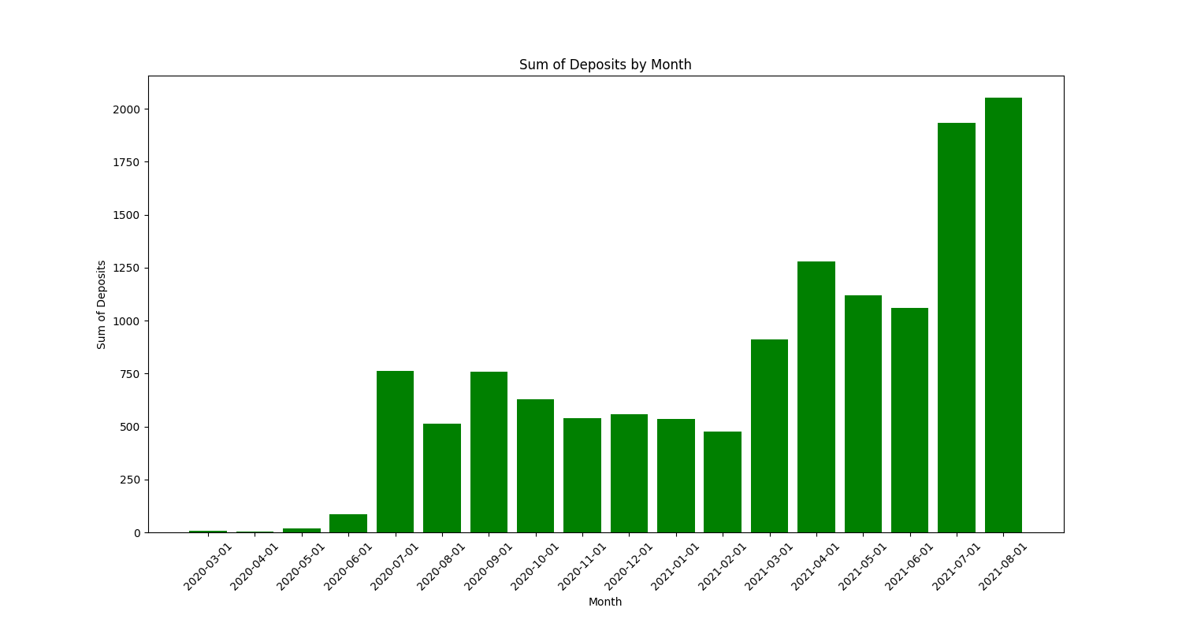
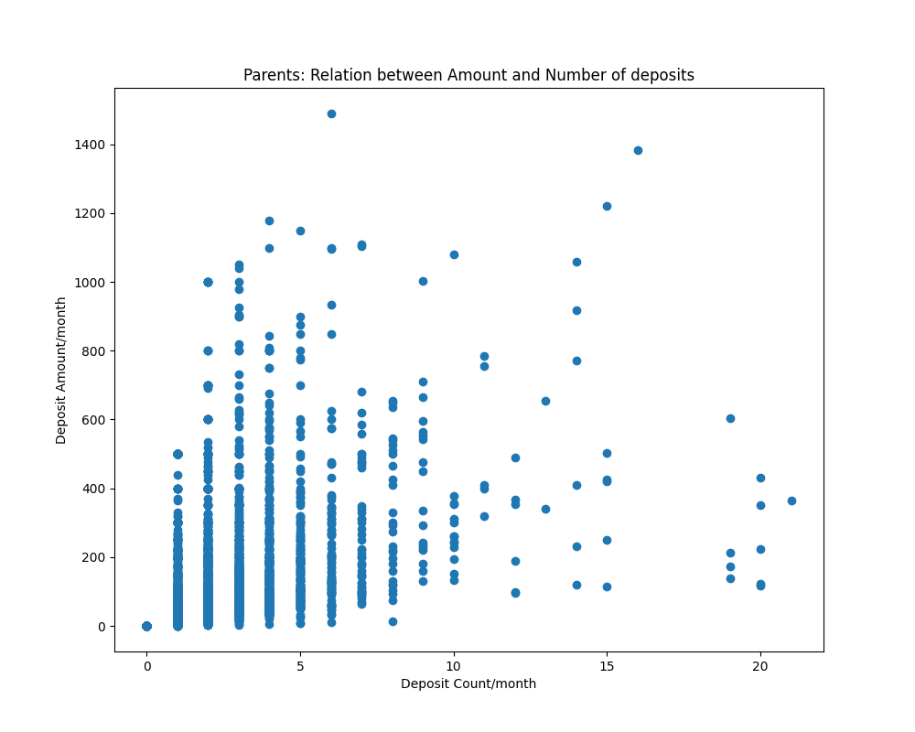
Data
 | cnt_user_login | trxn_amt | deposit_cnt | transfer_cnt | deposit_amt | transfer_amt
count | 18,857 | 9,083 | 9,083 | 9,083 | 7,239 | 8,150
mean | 4 | 11 | 1 | 4 | 107 | -82
std | 5 | 61 | 2 | 4 | 131 | 117
min | 1 | -580 | 0 | 0 | 1 | -1537
25% | 1 | -10 | 1 | 1 | 40 | -100
50% | 2 | 0 | 1 | 3 | 55 | -45
75% | 5 | 25 | 2 | 5 | 120 | -20
max | 91 | 1,000 | 21 | 30 | 1,490 | -1
Raw Data:
19,621 records
Structured data, with both categorical and numerical features
Clean Data:
19,621 records
Imputed missing values in numerical columns as 0
Standardize and normalize the data
Notes:
Describe raw data, basic descriptive stats etc
Describe and imputations
Assumptions
Data cleaning for Model

Slide 3
Model
Unsupervised Machine Learning for clustering
Used K-Nearest Neighbors to create clusters
Only numerical features used: ["trxn_amt", "deposit_cnt", "transfer_cnt", "deposit_amt", "transfer_amt"]
Used PCA for Data reduction. (See appendix Fig 1)
30 different cluster sizes were tested (1…30)
4 clusters are the best fit for this dataset. (See appendix Fig 2)
Notes:
Why unsupervised learning/clustering and KNN for this dataset?
Choosing the amount of clusters
Data reduction with PCA – don’t go into detail leave the info in the appendix

Slide 4
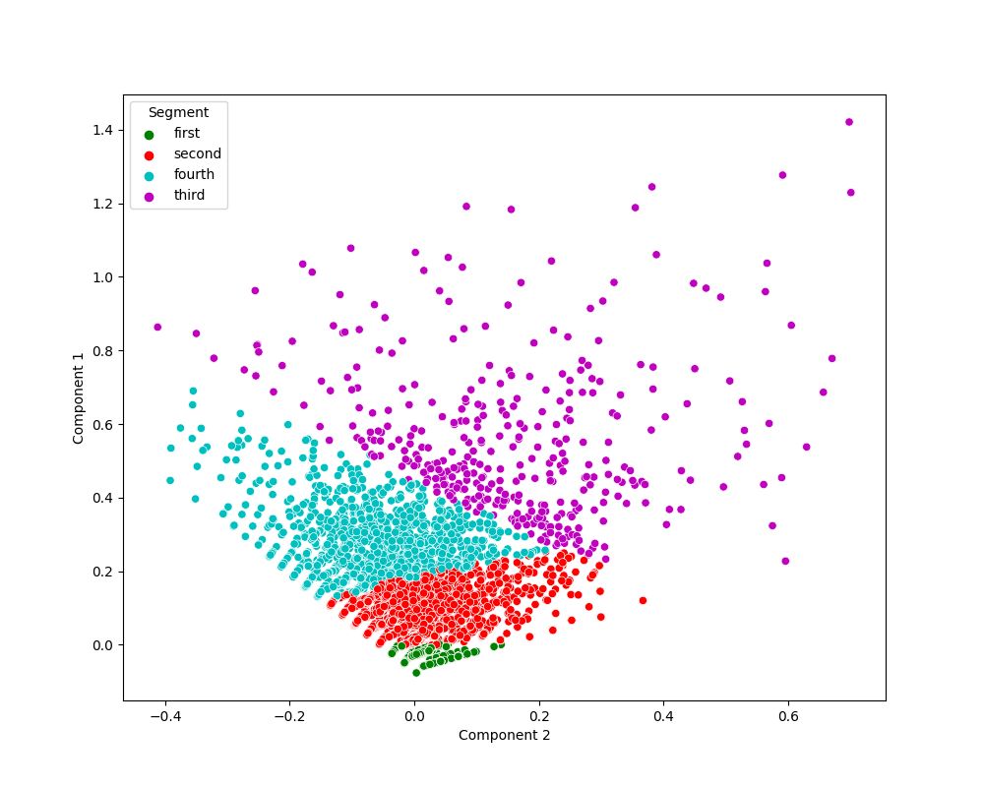
Analysis
 | First Cluster | Second Cluster | Third Cluster | Fourth Cluster
count | 13,380 | 4,373 | 374 | 1,494
Avg Trxn_Amt | 2.79 | 13.26 | 40.27 | -3.99
Avg Deposit_cnt | 0.15 | 1.37 | 5.37 | 2.17
Avg Transfer_cnt | 0.17 | 3.42 | 11.75 | 9.22
Avg Deposit_amt | 5.61 | 74.79 | 505.63 | 125.82
Avg Transfer_amt | -2.82 | -61.54 | -465.36 | -129.81
Approximately 77% of parents behaved like cluster 1. (March 1, 2020 – Aug 1, 2021).
Approximately 16% of parents behaved like cluster 2
Approximately 2% of parents behaved like cluster 3
Approximately 5% of parents behaved like cluster 4
Cluster 1 models the ‘inactive’ user
Cluster 2 models the ‘semi-active’ user
Cluster 3 models the ‘very-active’ user
Cluster 4 models the ‘active’ user
Notes:
Cluster Graph/Model result
Table of averages

Slide 5
What does this mean for the business?
More than half of the parents that have registered on the app are considered inactive.
We want more of our user base to behave at minimum, like cluster 3 or 4 (very active or active)
Targeted marketing. Specific marketing offers based on clustering statistics.
We can provide marketing offers/deals to inactive parents, to motivate them to deposit more money into Mydoh. (E.g. match your deposit up to $20)
We can also provide marketing offers/deals to active users, to continue motivating them to stay active on Mydoh
Notes:
Targeted marketing

Slide 6
Conclusion
Calculating statistical attributes (mean, std, etc) of the raw data give us some insights into user behavior.
To calculate more complex relationships the raw data needs to be cleaned
The clean data was then clustered using K-Nearest Neighbors with 4 clusters
This allowed for a statistical description, of the different types of user behaviors present in the data set
We can now target specific users via marketing depending on which cluster they are in
Notes:
Data cleaned
Created KNN
4 clusters which tell us ….
This is how we can use the info from clusters to improve business
Thank you!

Slide 7
Appendix
Code is uploaded to my github (dataset is not uploaded): https://github.com/usman-naveed/Inhouse-Assignment

Slide 8
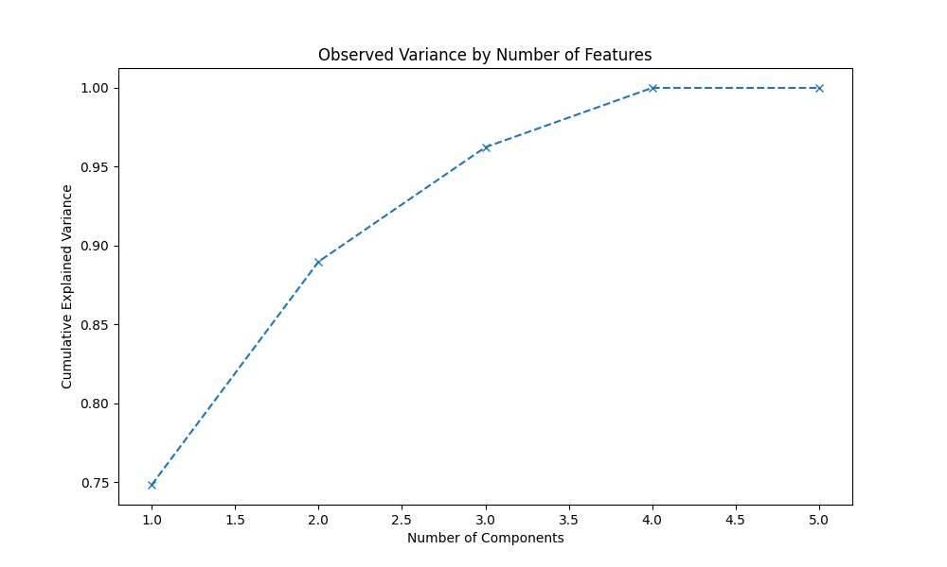
Appendix cont’d
Figure 1

Slide 9
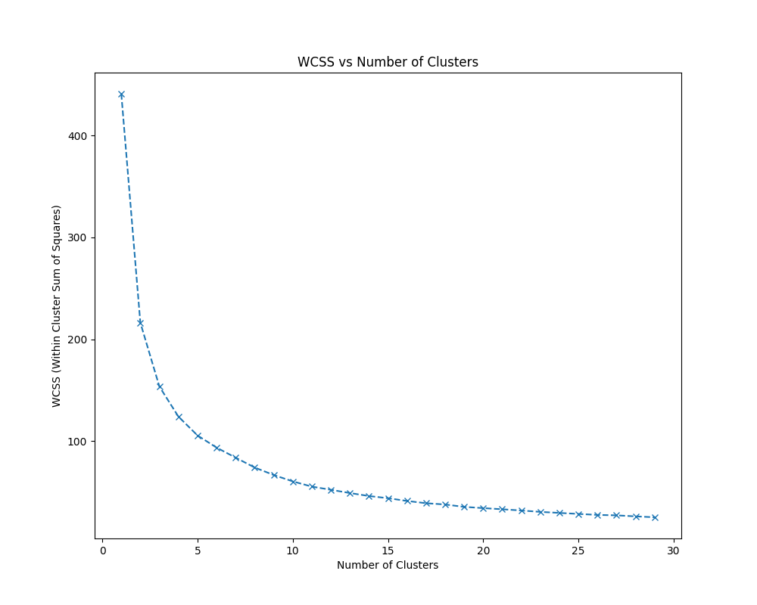
Appendix cont’d
Figure 2

